Slide 1
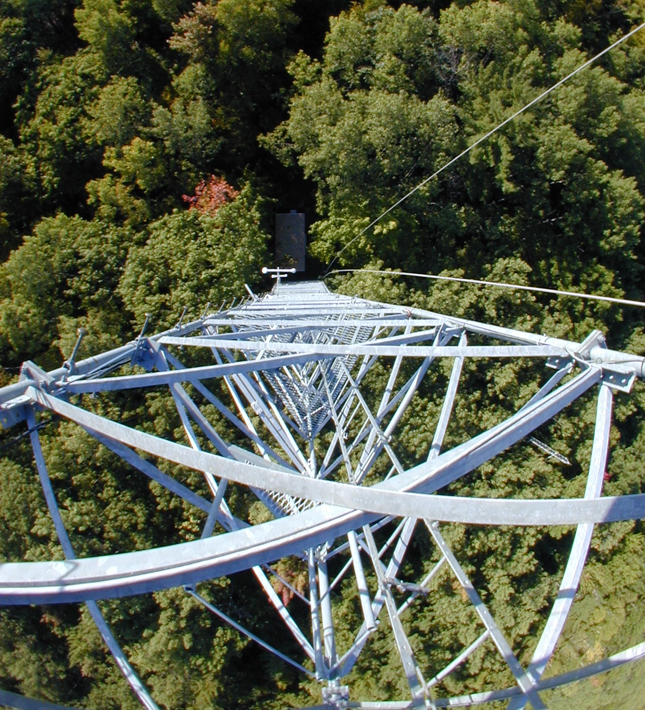
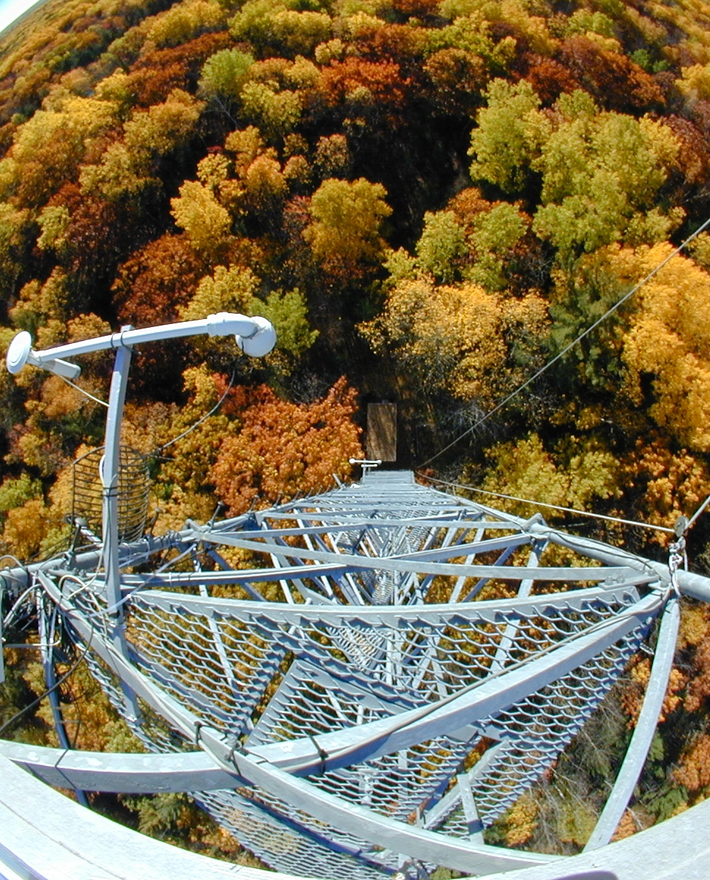
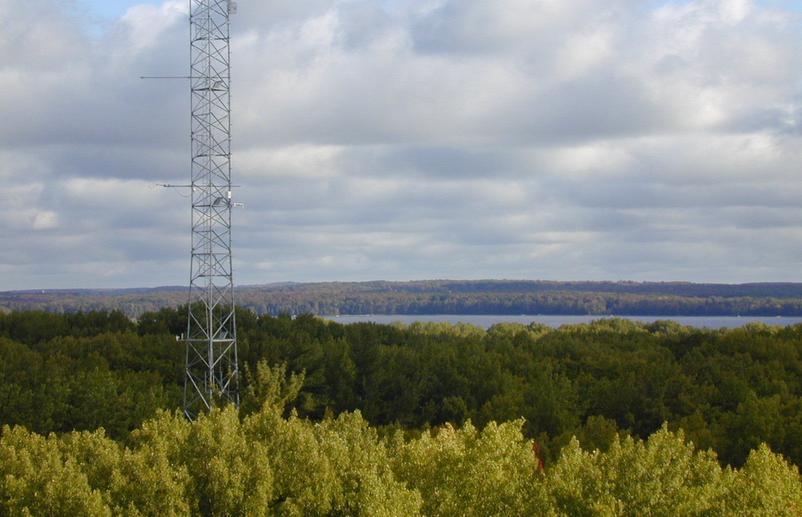
Eddy-Covariance Fundamentals
From: Gough, C. M., Giffen, C., Woodward, T. W. (2018). Environmental Drivers of Ecosystem Carbon Fluxes from Minutes to Years. NEON Faculty Mentoring Network, QUBES Educational Resources. doi:10.25334/Q4VD7W
Images: C. Gough

Slide 2
NEON Education video: “Eddy Covariance: Measuring an Ecosystem's Breath”
https://youtu.be/CR4Anc8Mkas
Notes:
This NEON Science video

Slide 3
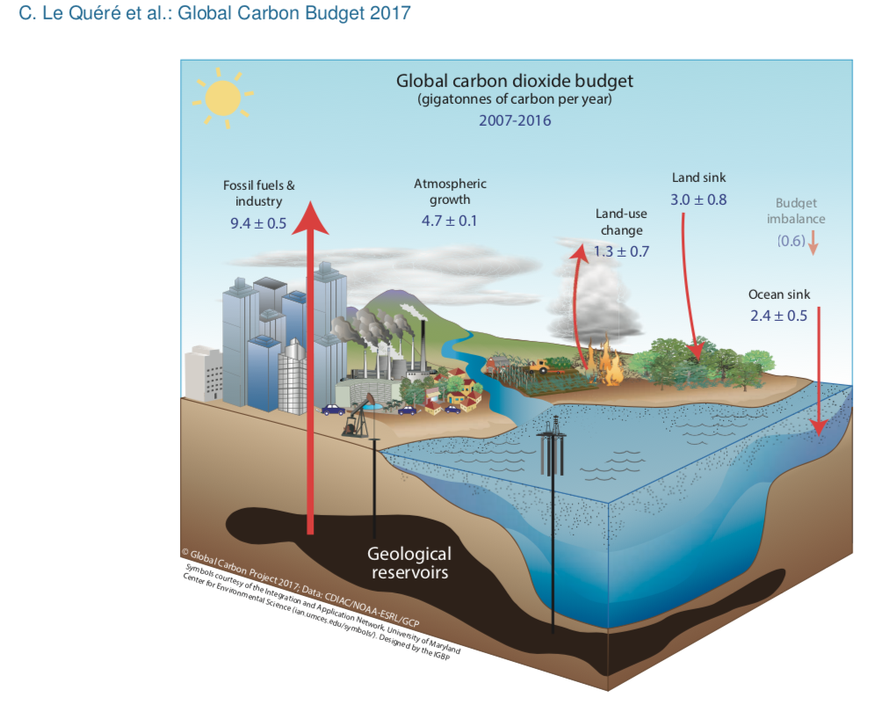
Global Carbon Budget
Pg C yr⁻¹
44%
28%
22%
Le Quéré et al. 2017
Global Carbon Project

Slide 4
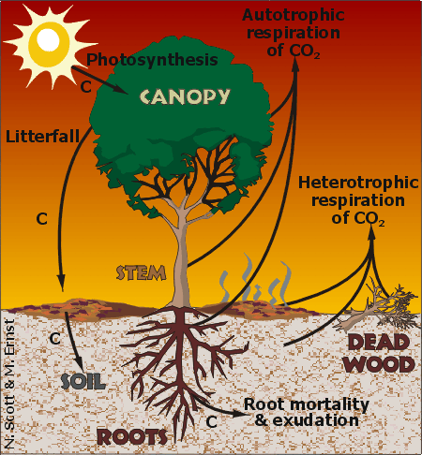
The challenge: estimating ecosystem-scale carbon fluxes at high temporal resolution
Net ecosystem production =
Gross primary production – Ecosystem respiration,
Usually expressed as annual rate
Net ecosystem CO₂ exchange =
Same as above, but usually expressed as instantaneous rate

Slide 5
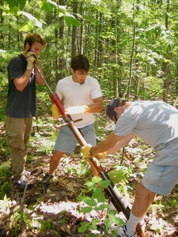
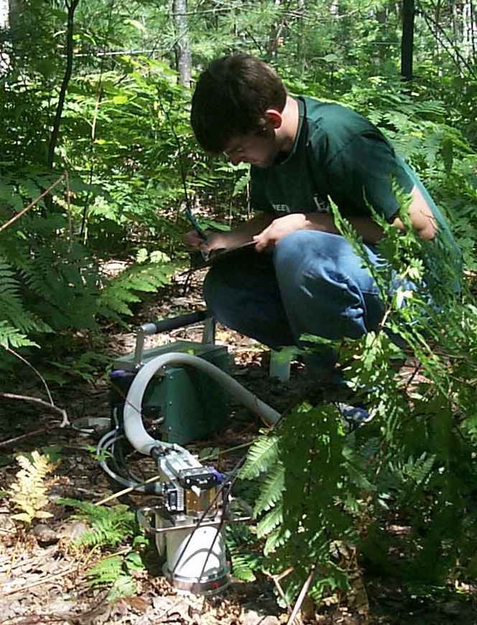
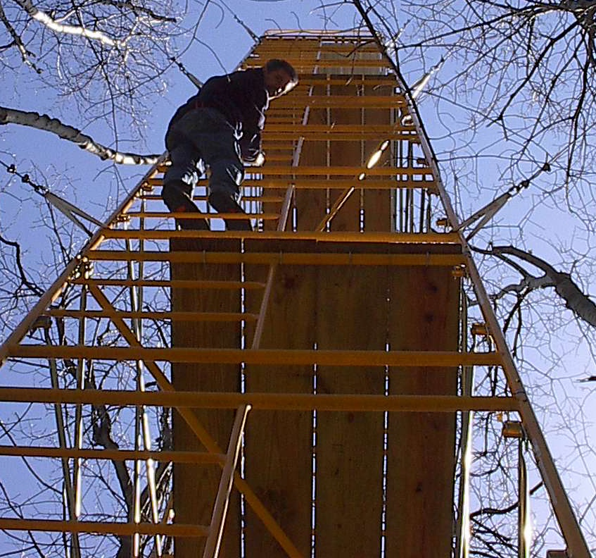
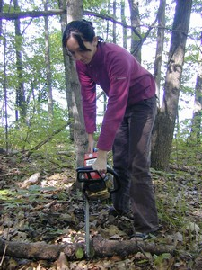
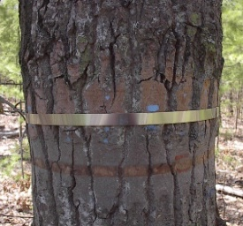
Inventory method
Net ecosystem production = Net primary production – Heterotrophic respiration
CO₂
Live wood
Roots
Dead wood
Leaves
Heterotrophic
respiration
Images: C. Gough and P. Curtis

Slide 6
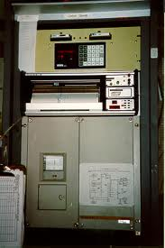
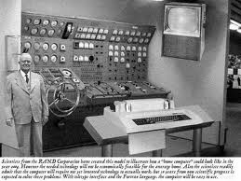
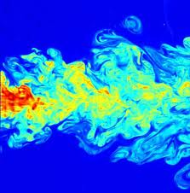
Advances in early 90’s set stage for broad use of eddy-covariance
Instrumentation: IRGA and wind speed sensors (anemometers).
Data analysis and storage: Computer processing and hard drive space
Methodological development: Developed from fluid dynamics, meteorological, and engineering principles
Old IRGAs were the size of refrigerators
Images: Wikipedia

Slide 7
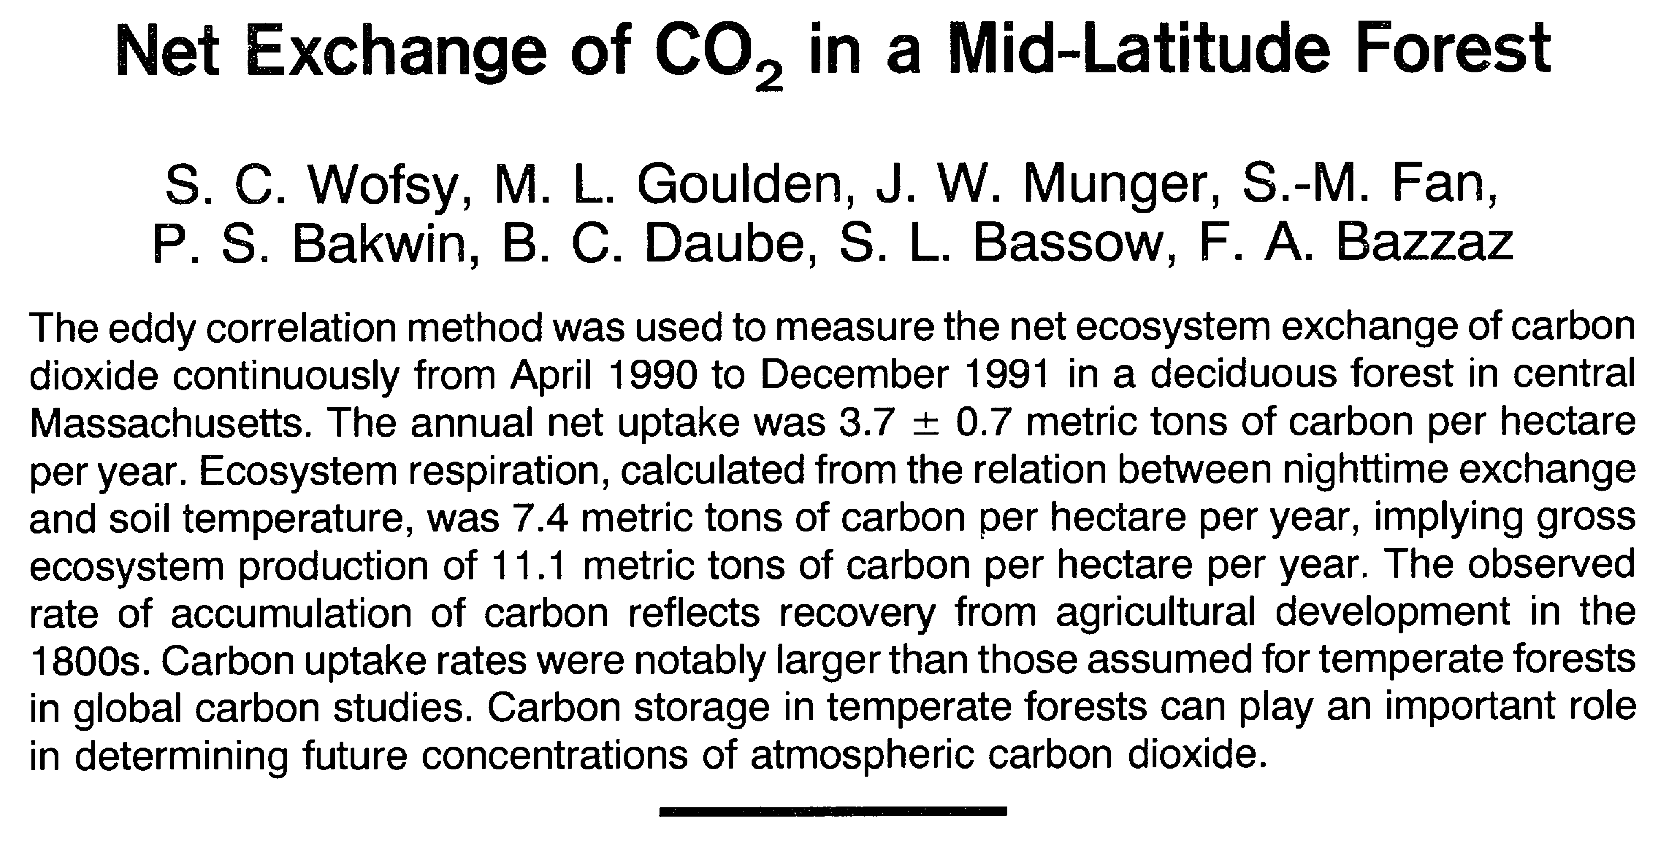
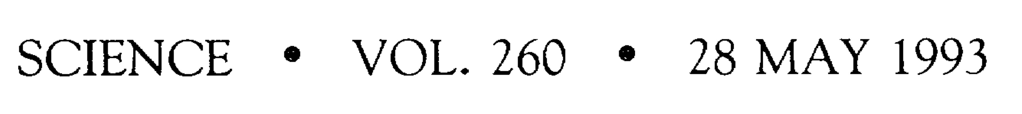
First paper on eddy-covariance 25 years ago from Harvard Forest

Slide 8
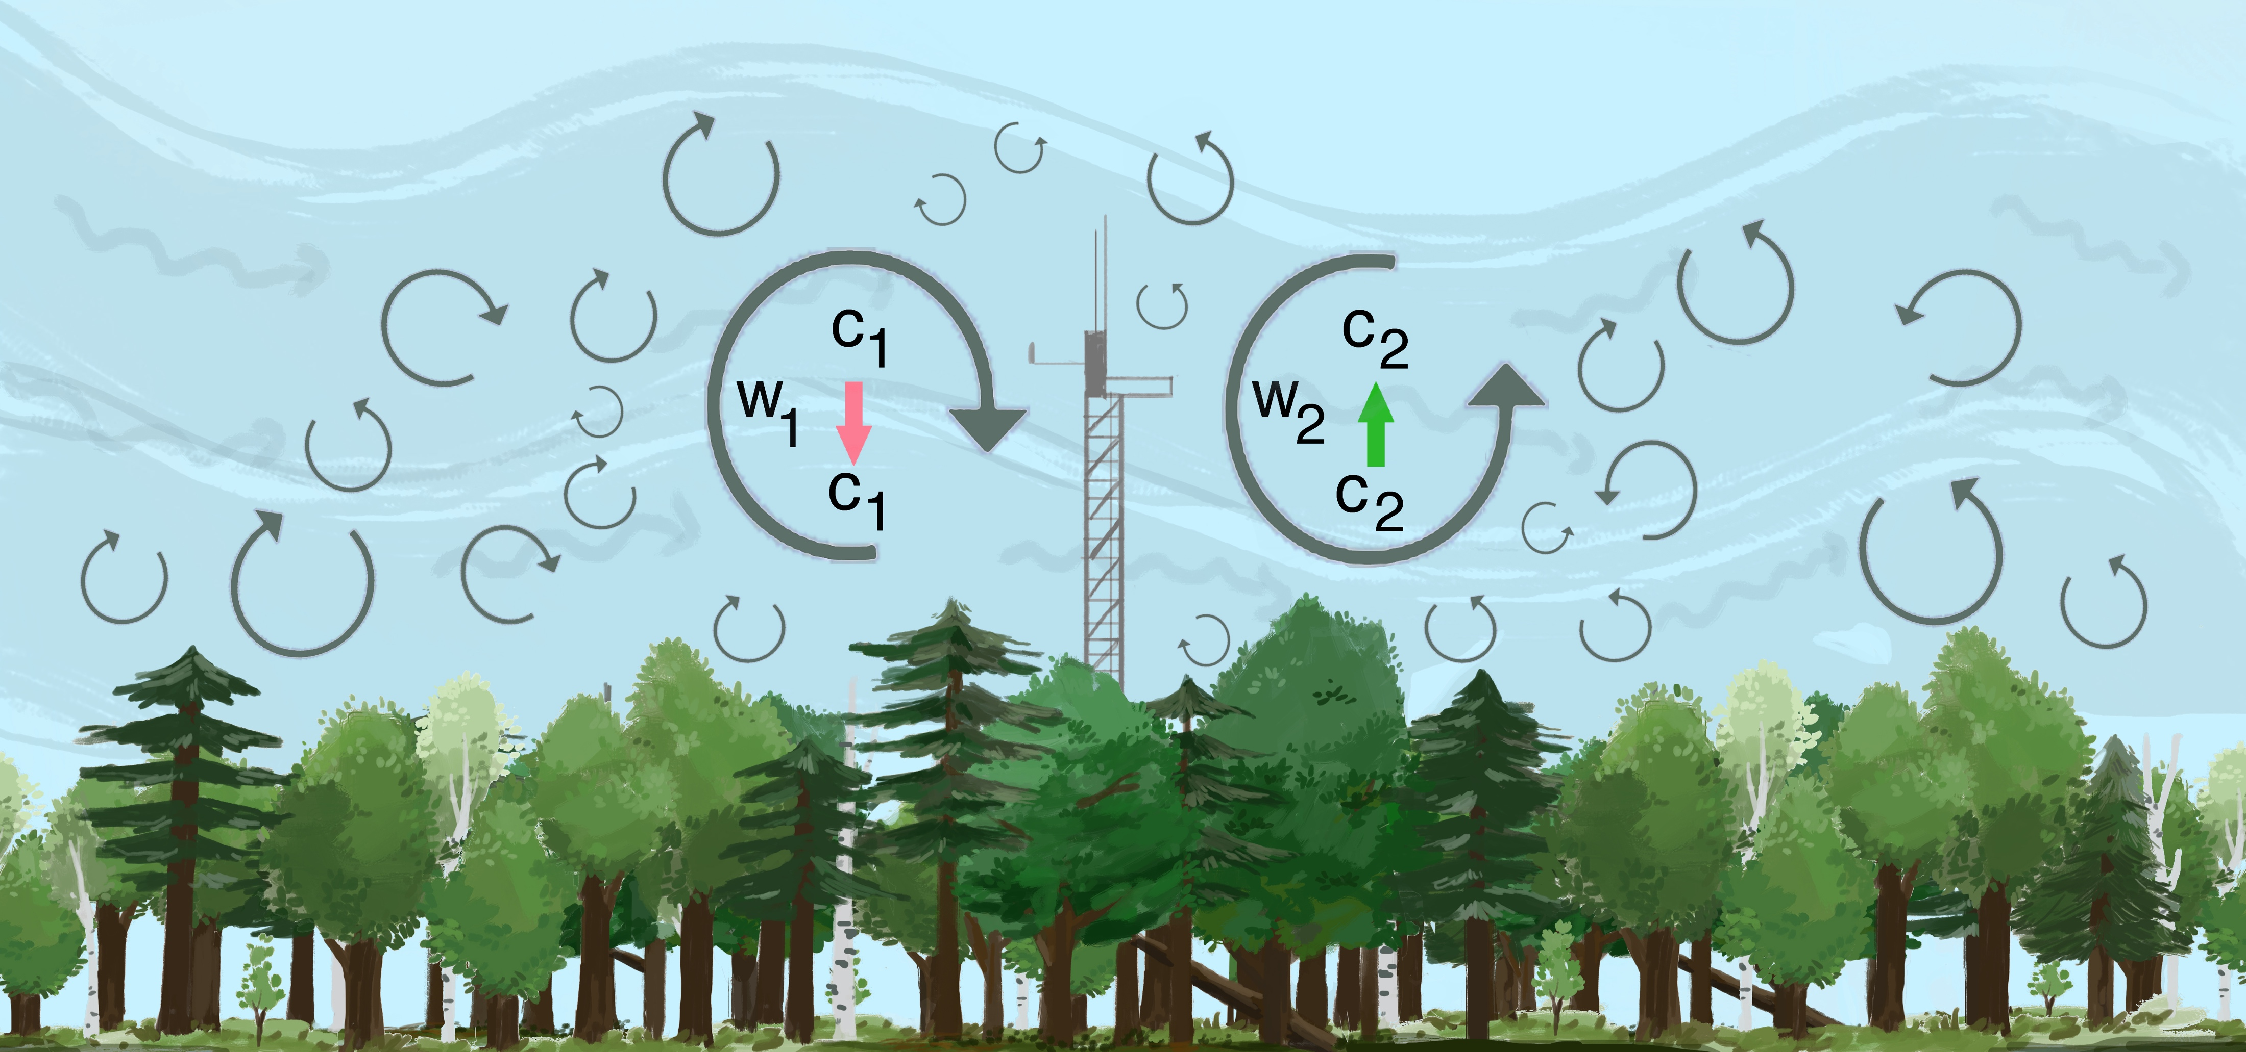
Eddy-covariance theory
Artist: Catherine McGuigan, VCU BS ‘18
Notes:
For a primer of eddy-covariance see box 1 of: https://nph.onlinelibrary.wiley.com/doi/10.1111/nph.15227 and https://en.wikipedia.org/wiki/Eddy_covariance

Slide 9
Flux (F) derived from eddy-covariance
Velocity of air moved upward or downward (m s⁻¹)
Fluctuation of [CO2] from mean
(g kg air⁻¹)
Density of air
(kg air m⁻³)
The covariance is calculated between the fluctuating component of the vertical wind and the fluctuating component of gas concentration.
Source: Burba, G., 2013. Eddy Covariance Method for Scientific, Industrial, Agricultural, and Regulatory Applications: A Field Book on Measuring Ecosystem Gas Exchange and Areal Emission Rates. LI-COR Biosciences, Lincoln, NE, USA, 331 pp.

Slide 10
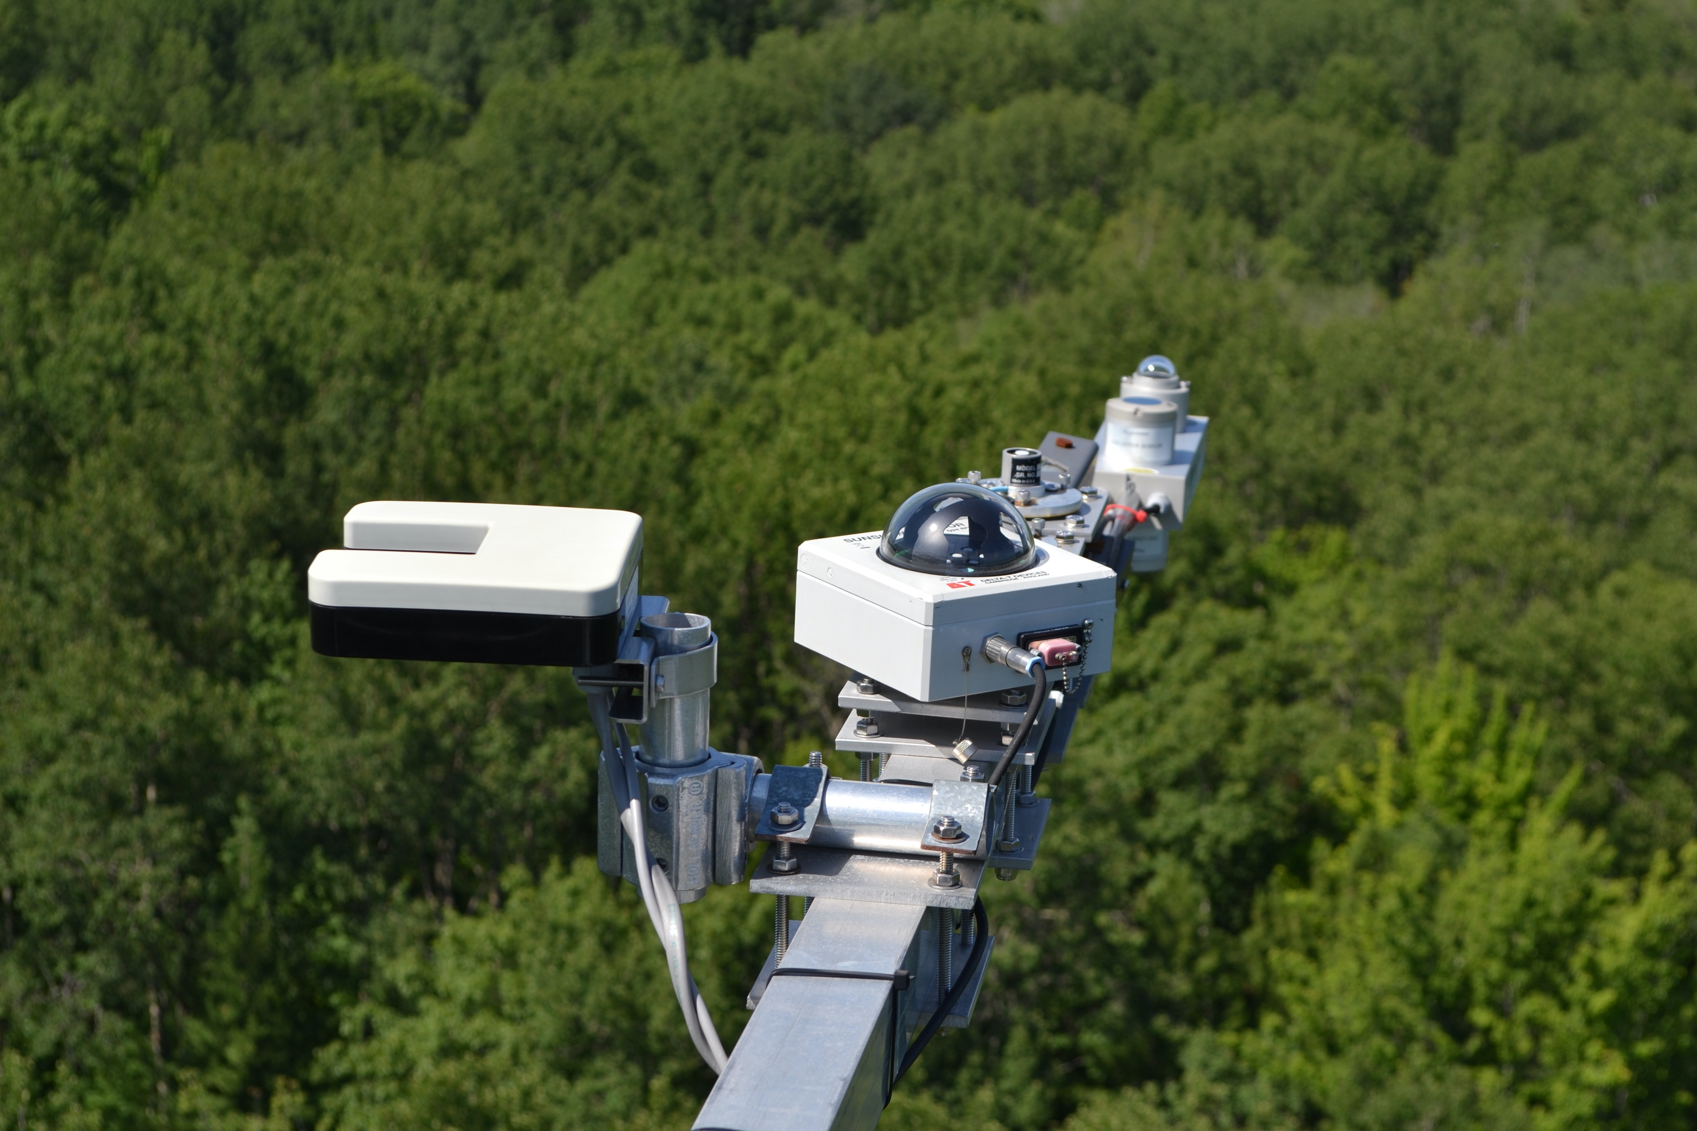
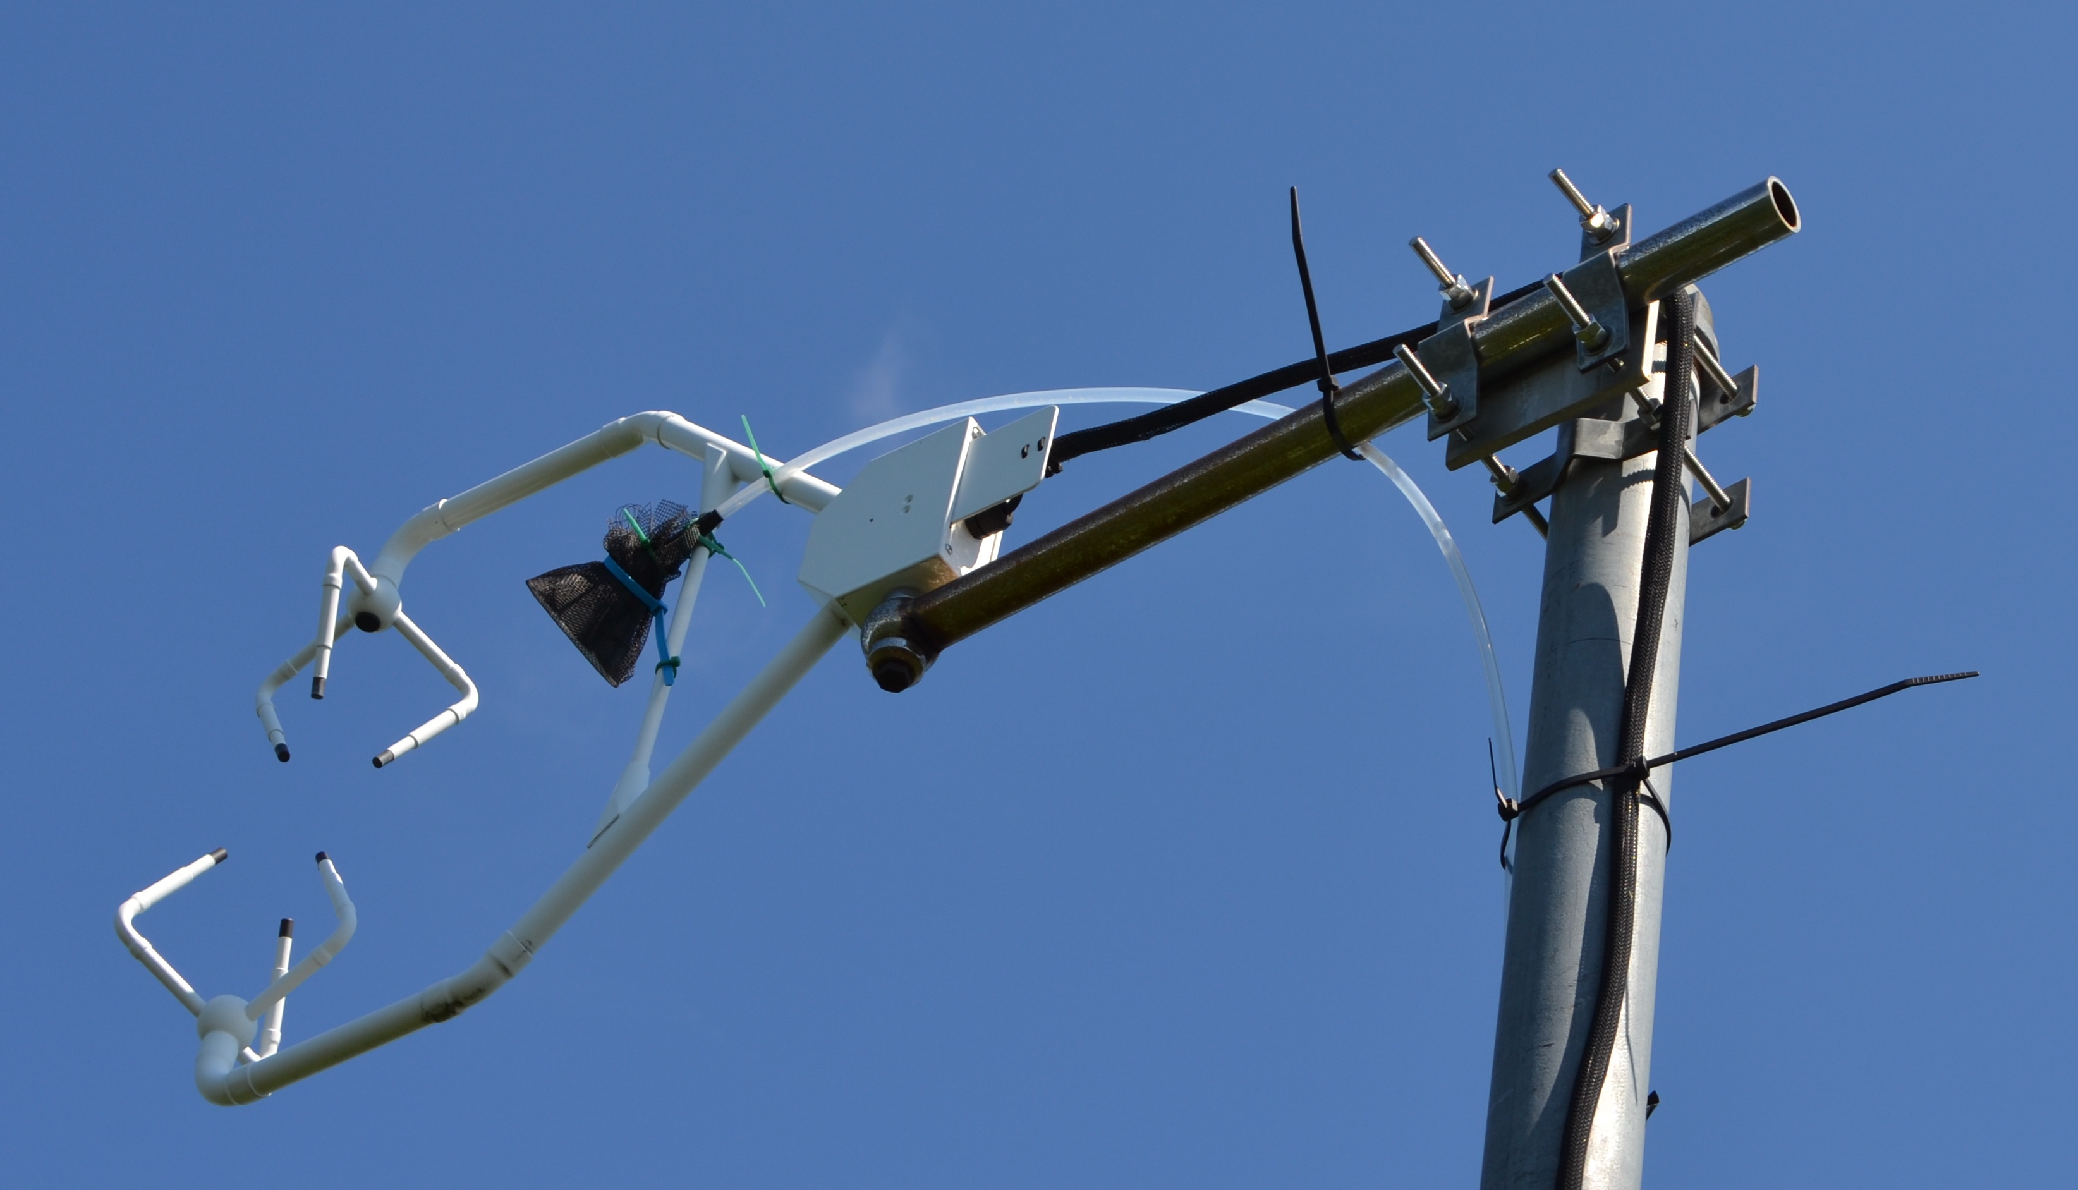
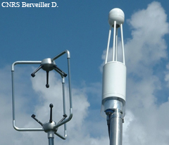
Eddy-covariance instrumentation
Air intake to IRGA (closed path)
3-D Sonic Anemometer
Thermocouple and other climate sensors
Open path IRGA
Images: C. Gough and C. Vogel; and http://www.ese.u-psud.fr/IMG/jpg/Li-7500ter-2.jpg

Slide 11
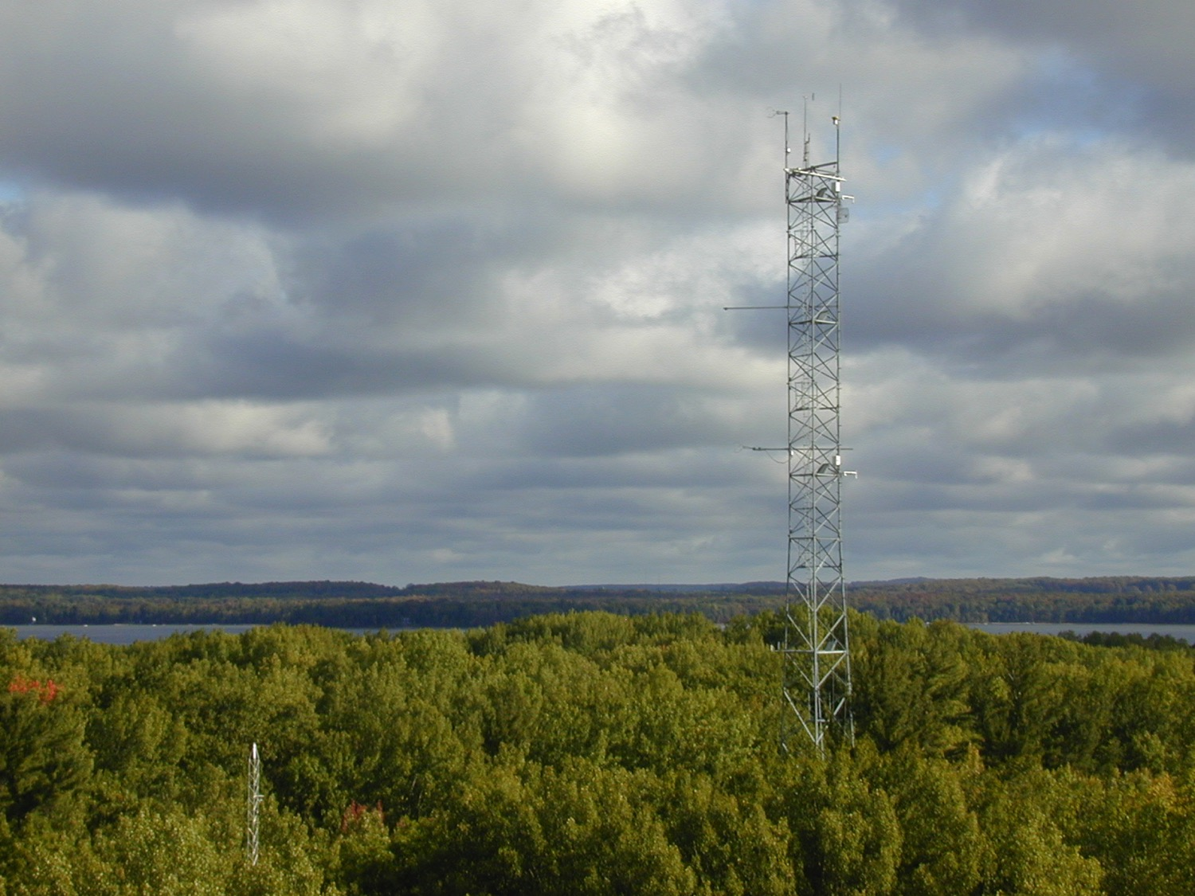
Image: C. Gough
Notes:
Eddy-covariance tower in a temperate forest ecosystem

Slide 12
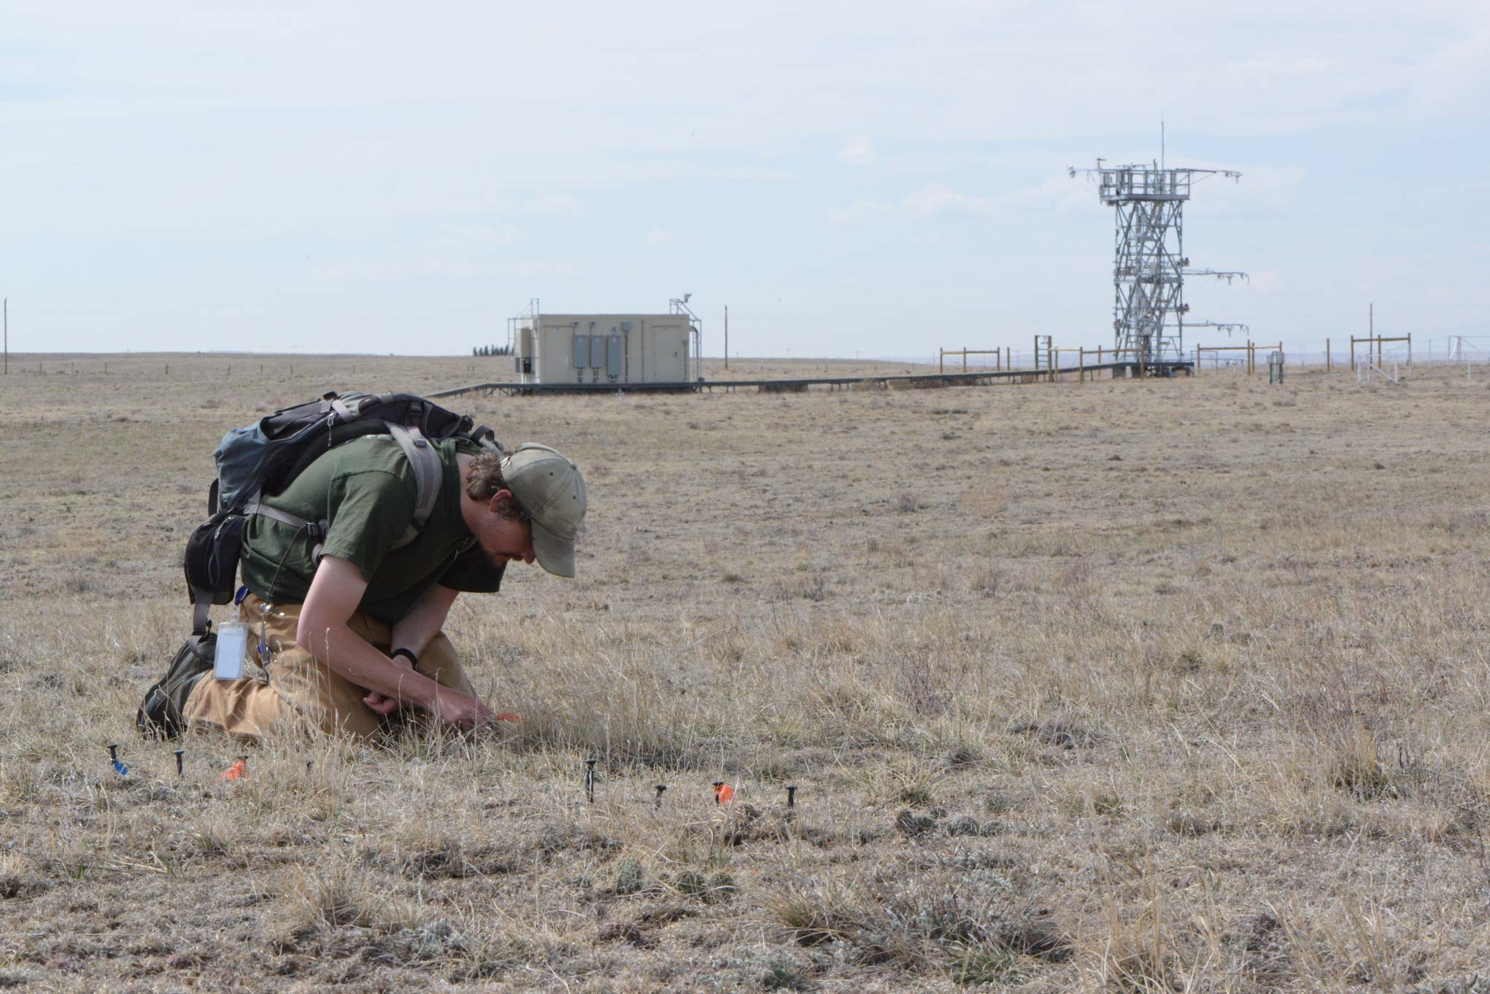
Terrestrial Observation System (TOS)
Image: NEON
Notes:
Eddy-covariance tower in the Central US plains

Slide 13
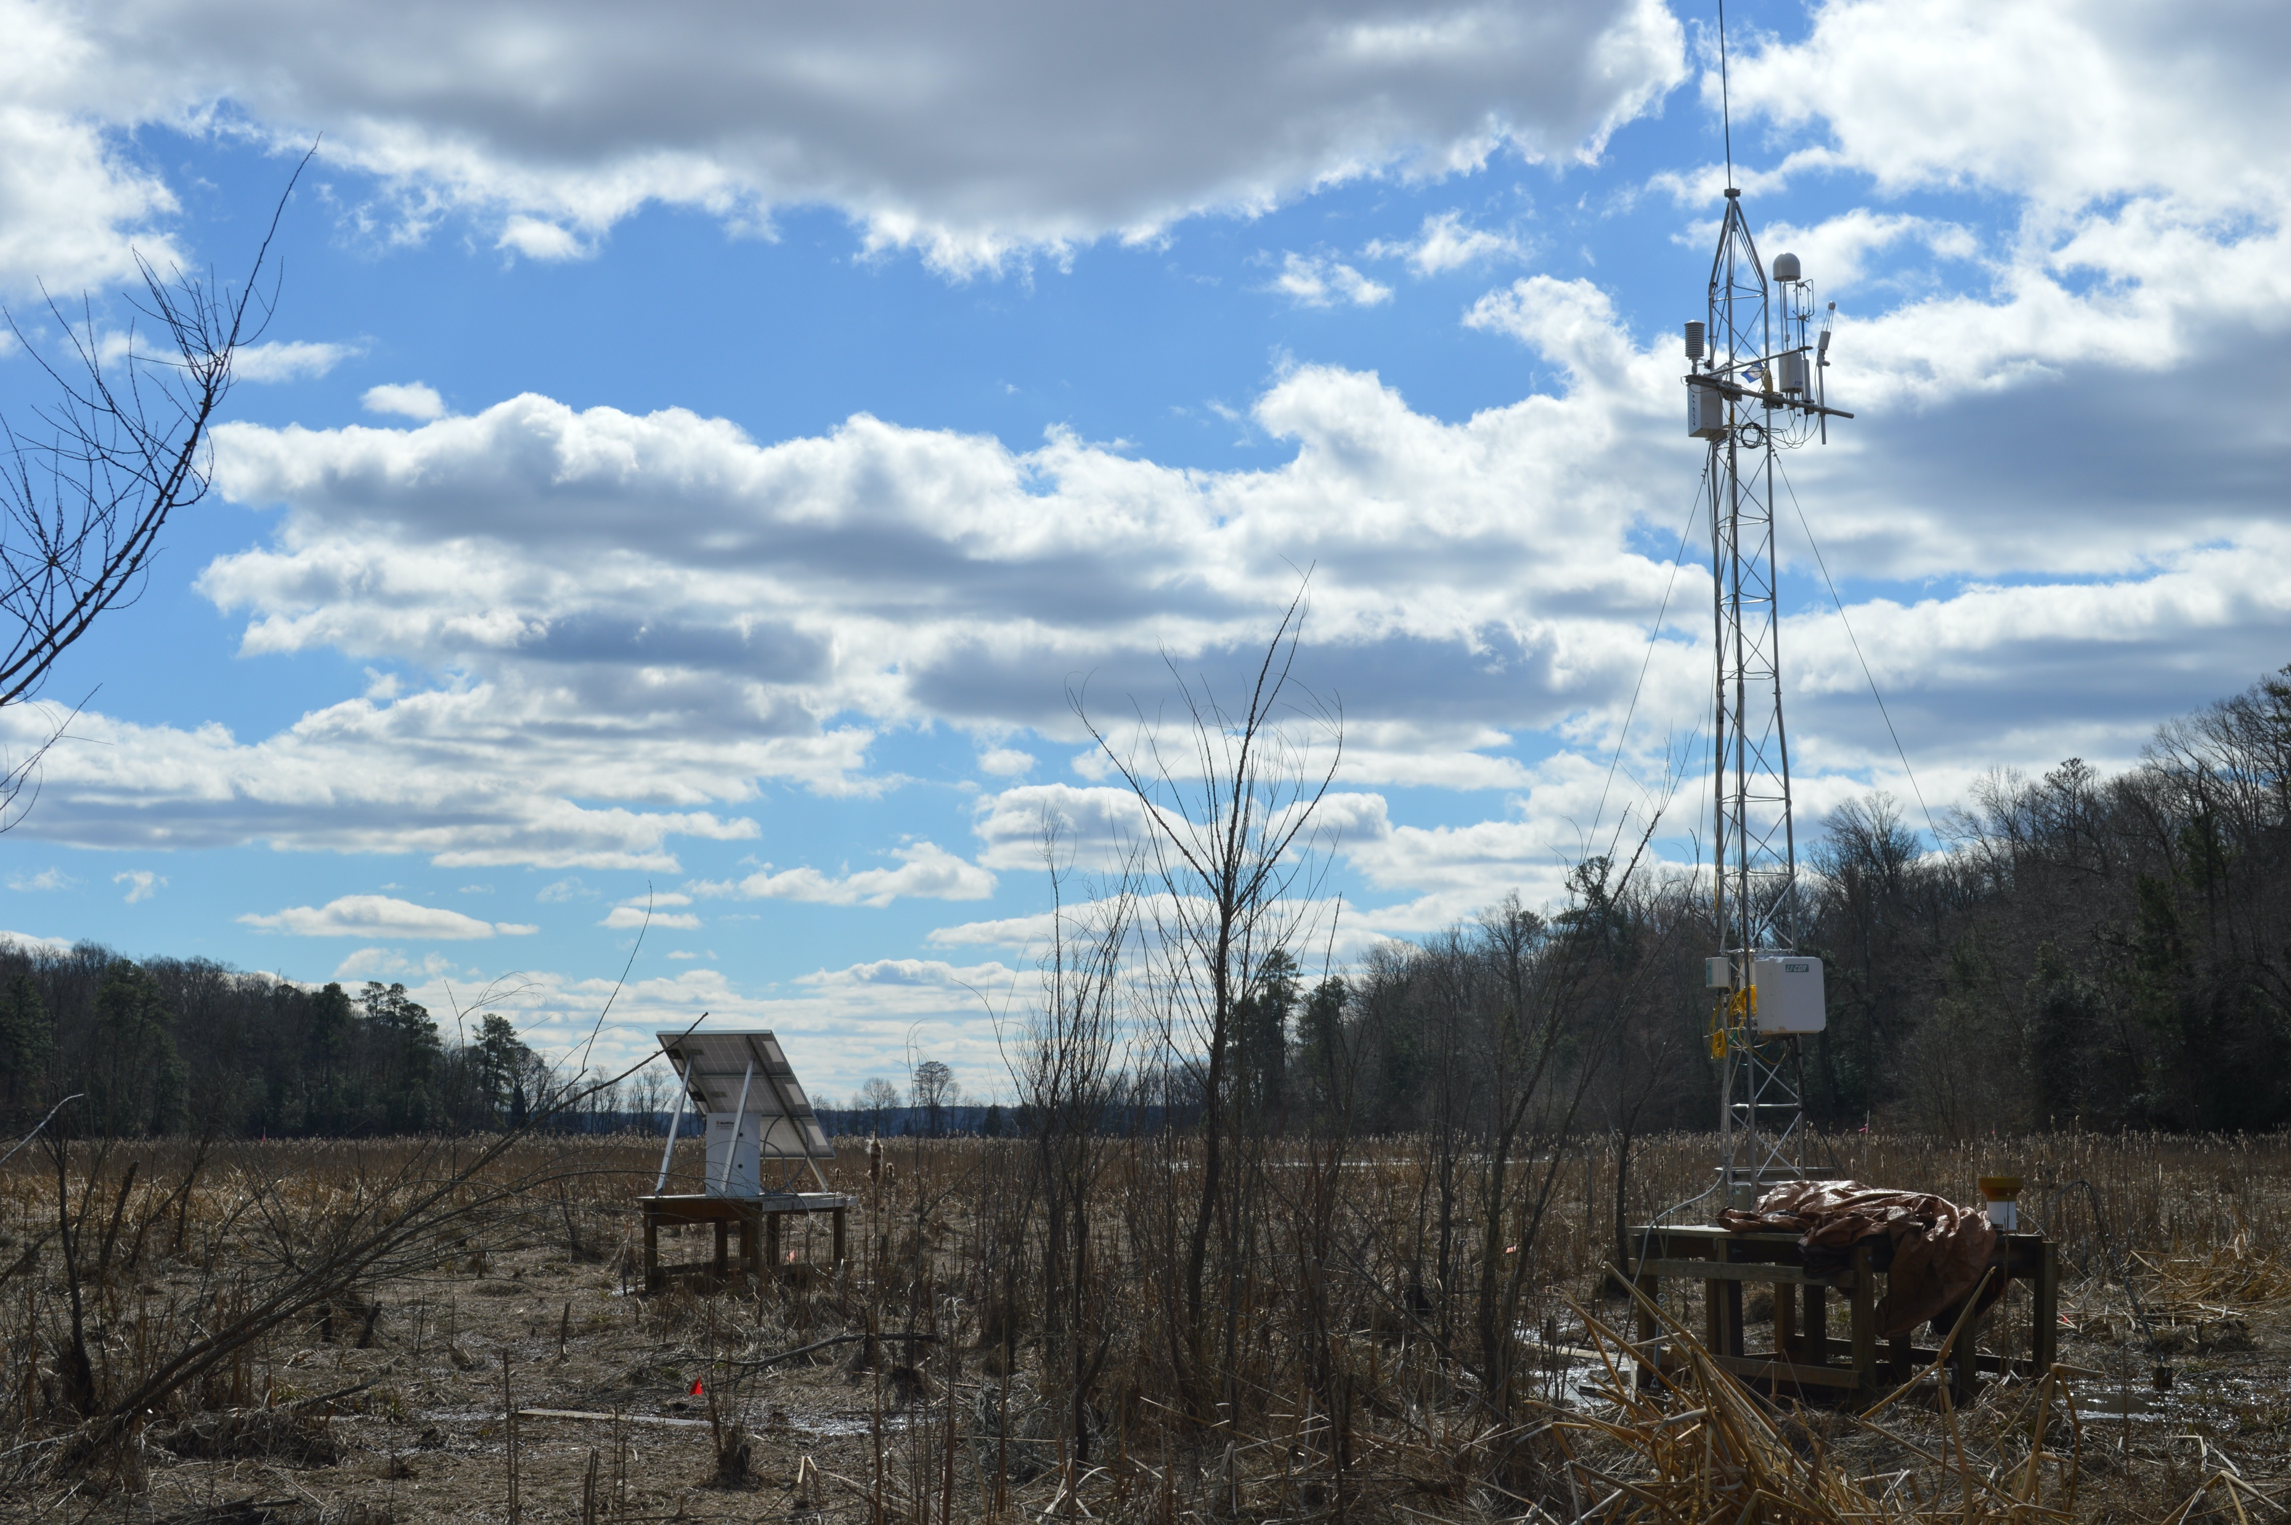
Image: C. Gough
Notes:
Eddy-covariance tower in a tidal wetland

Slide 14
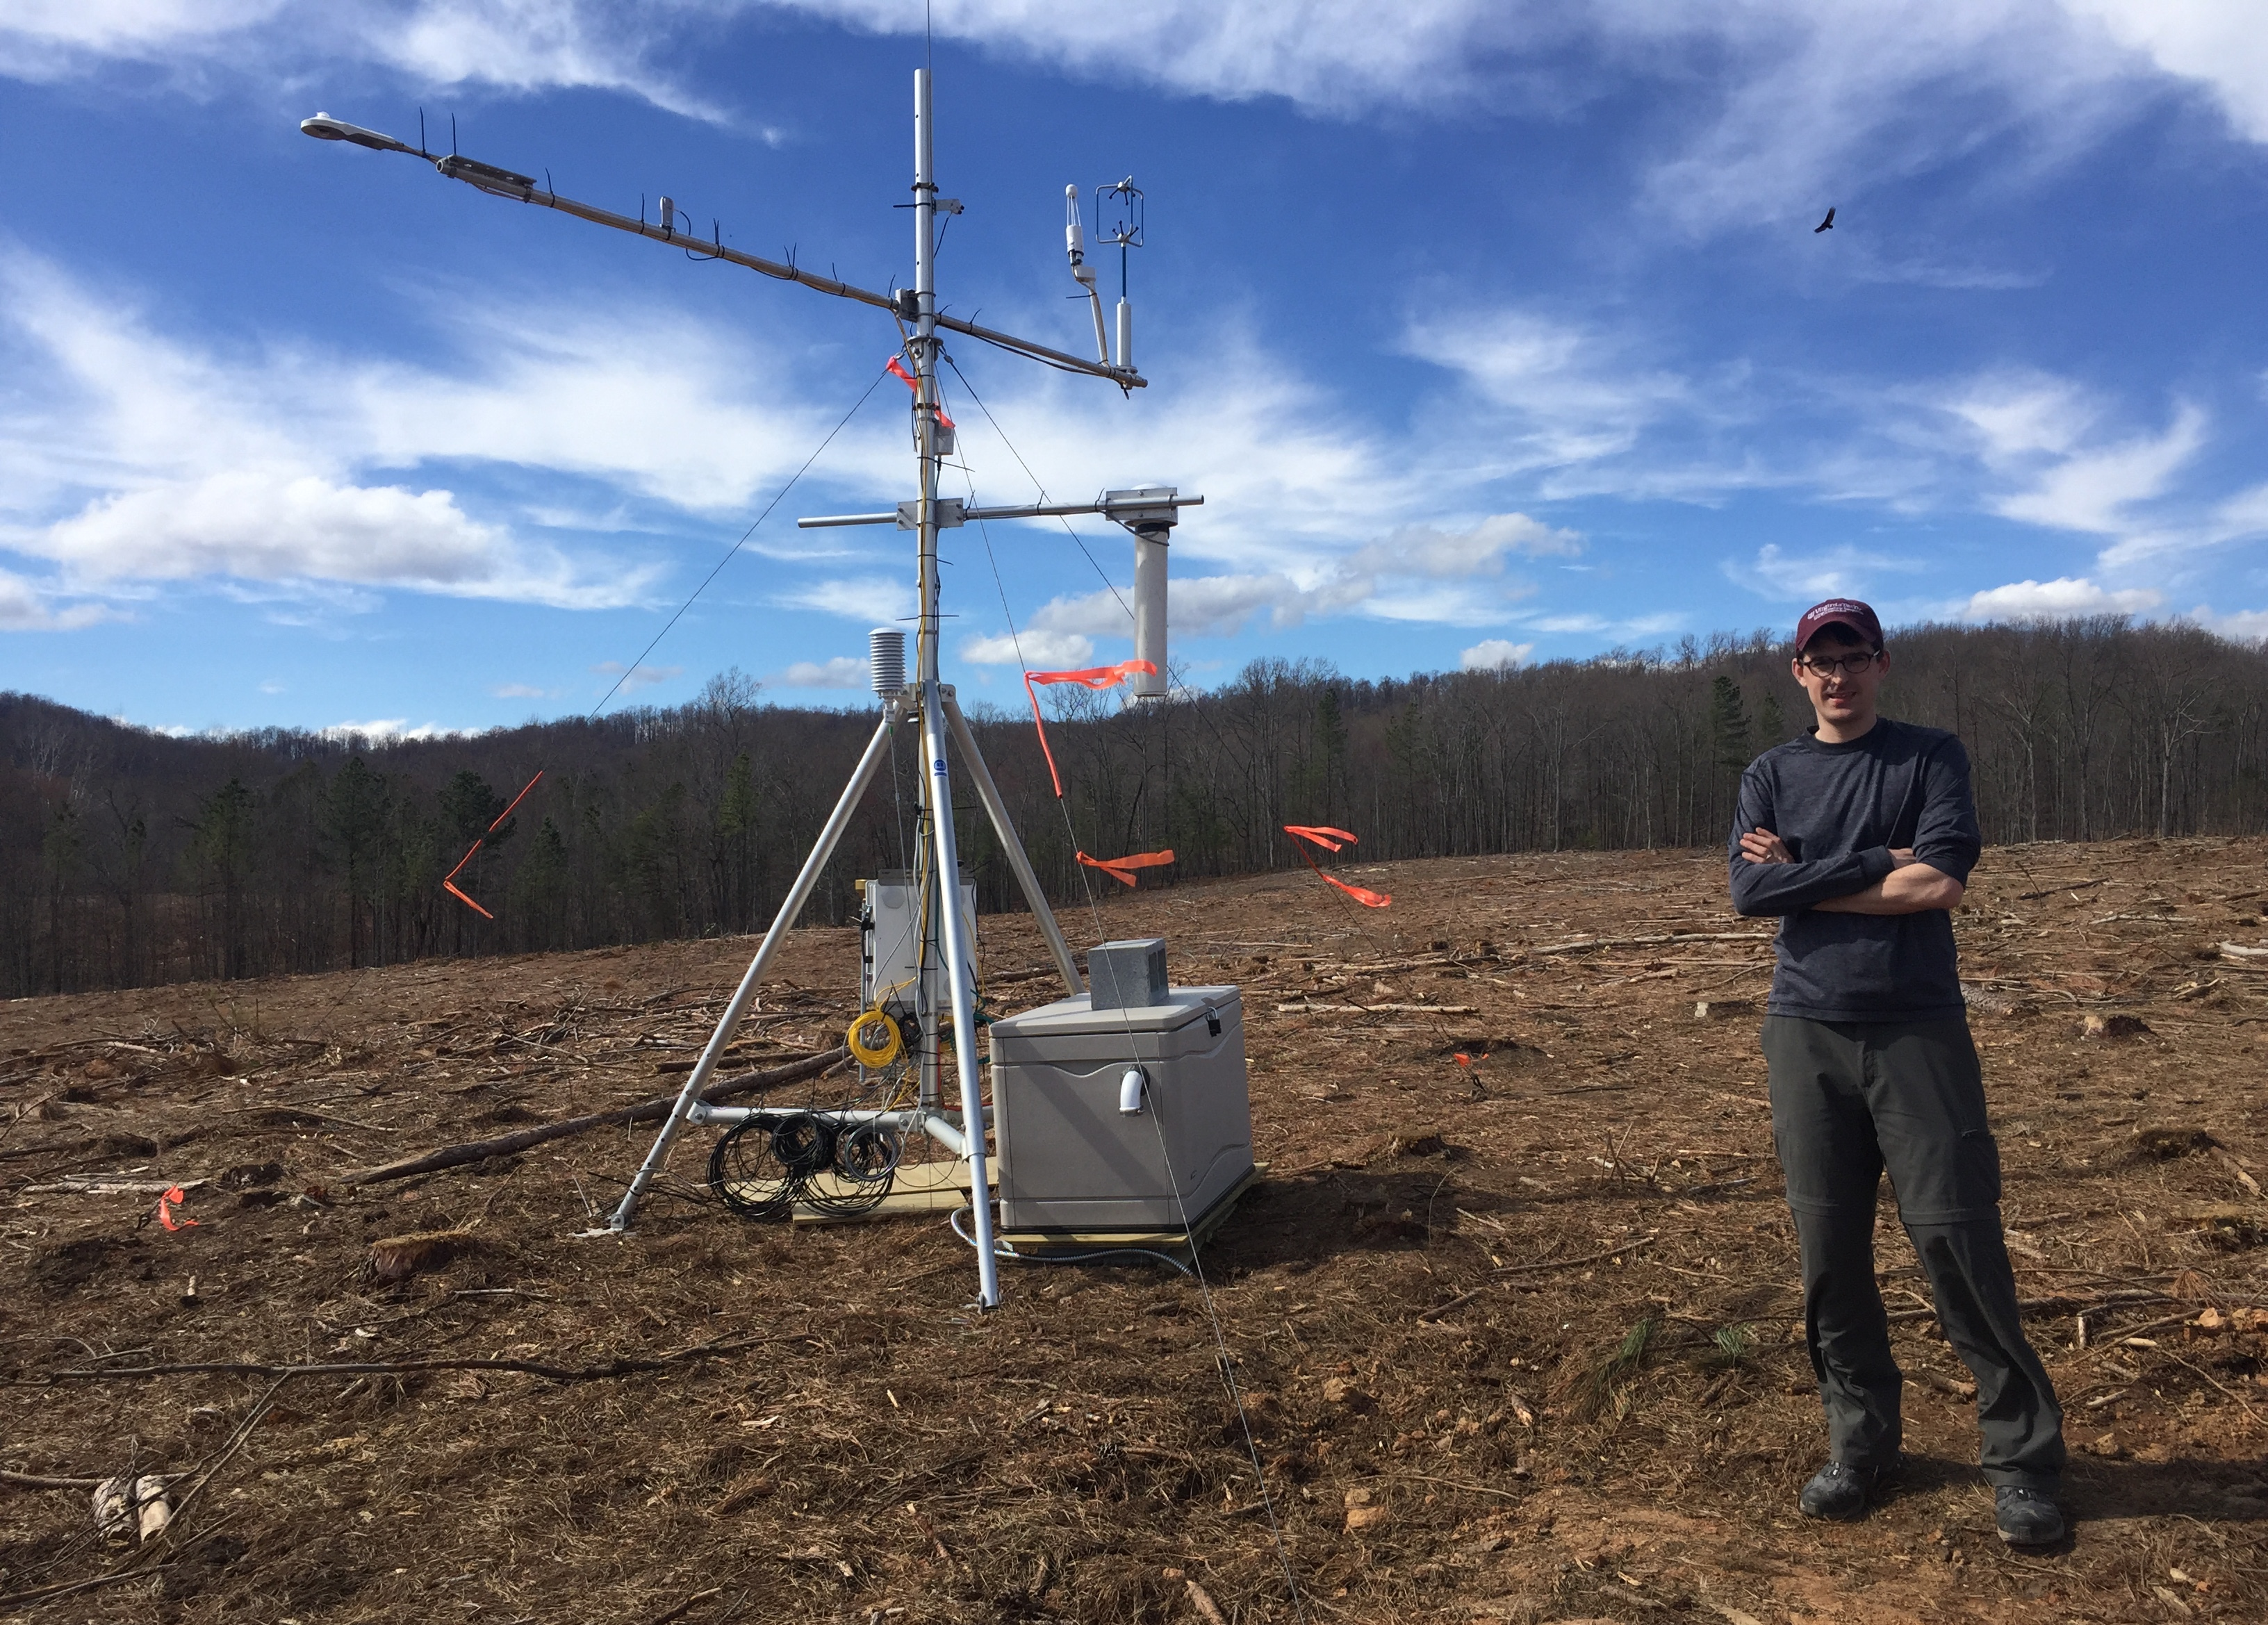
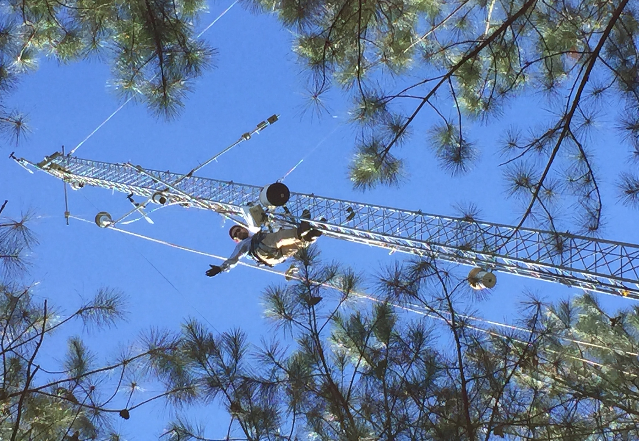
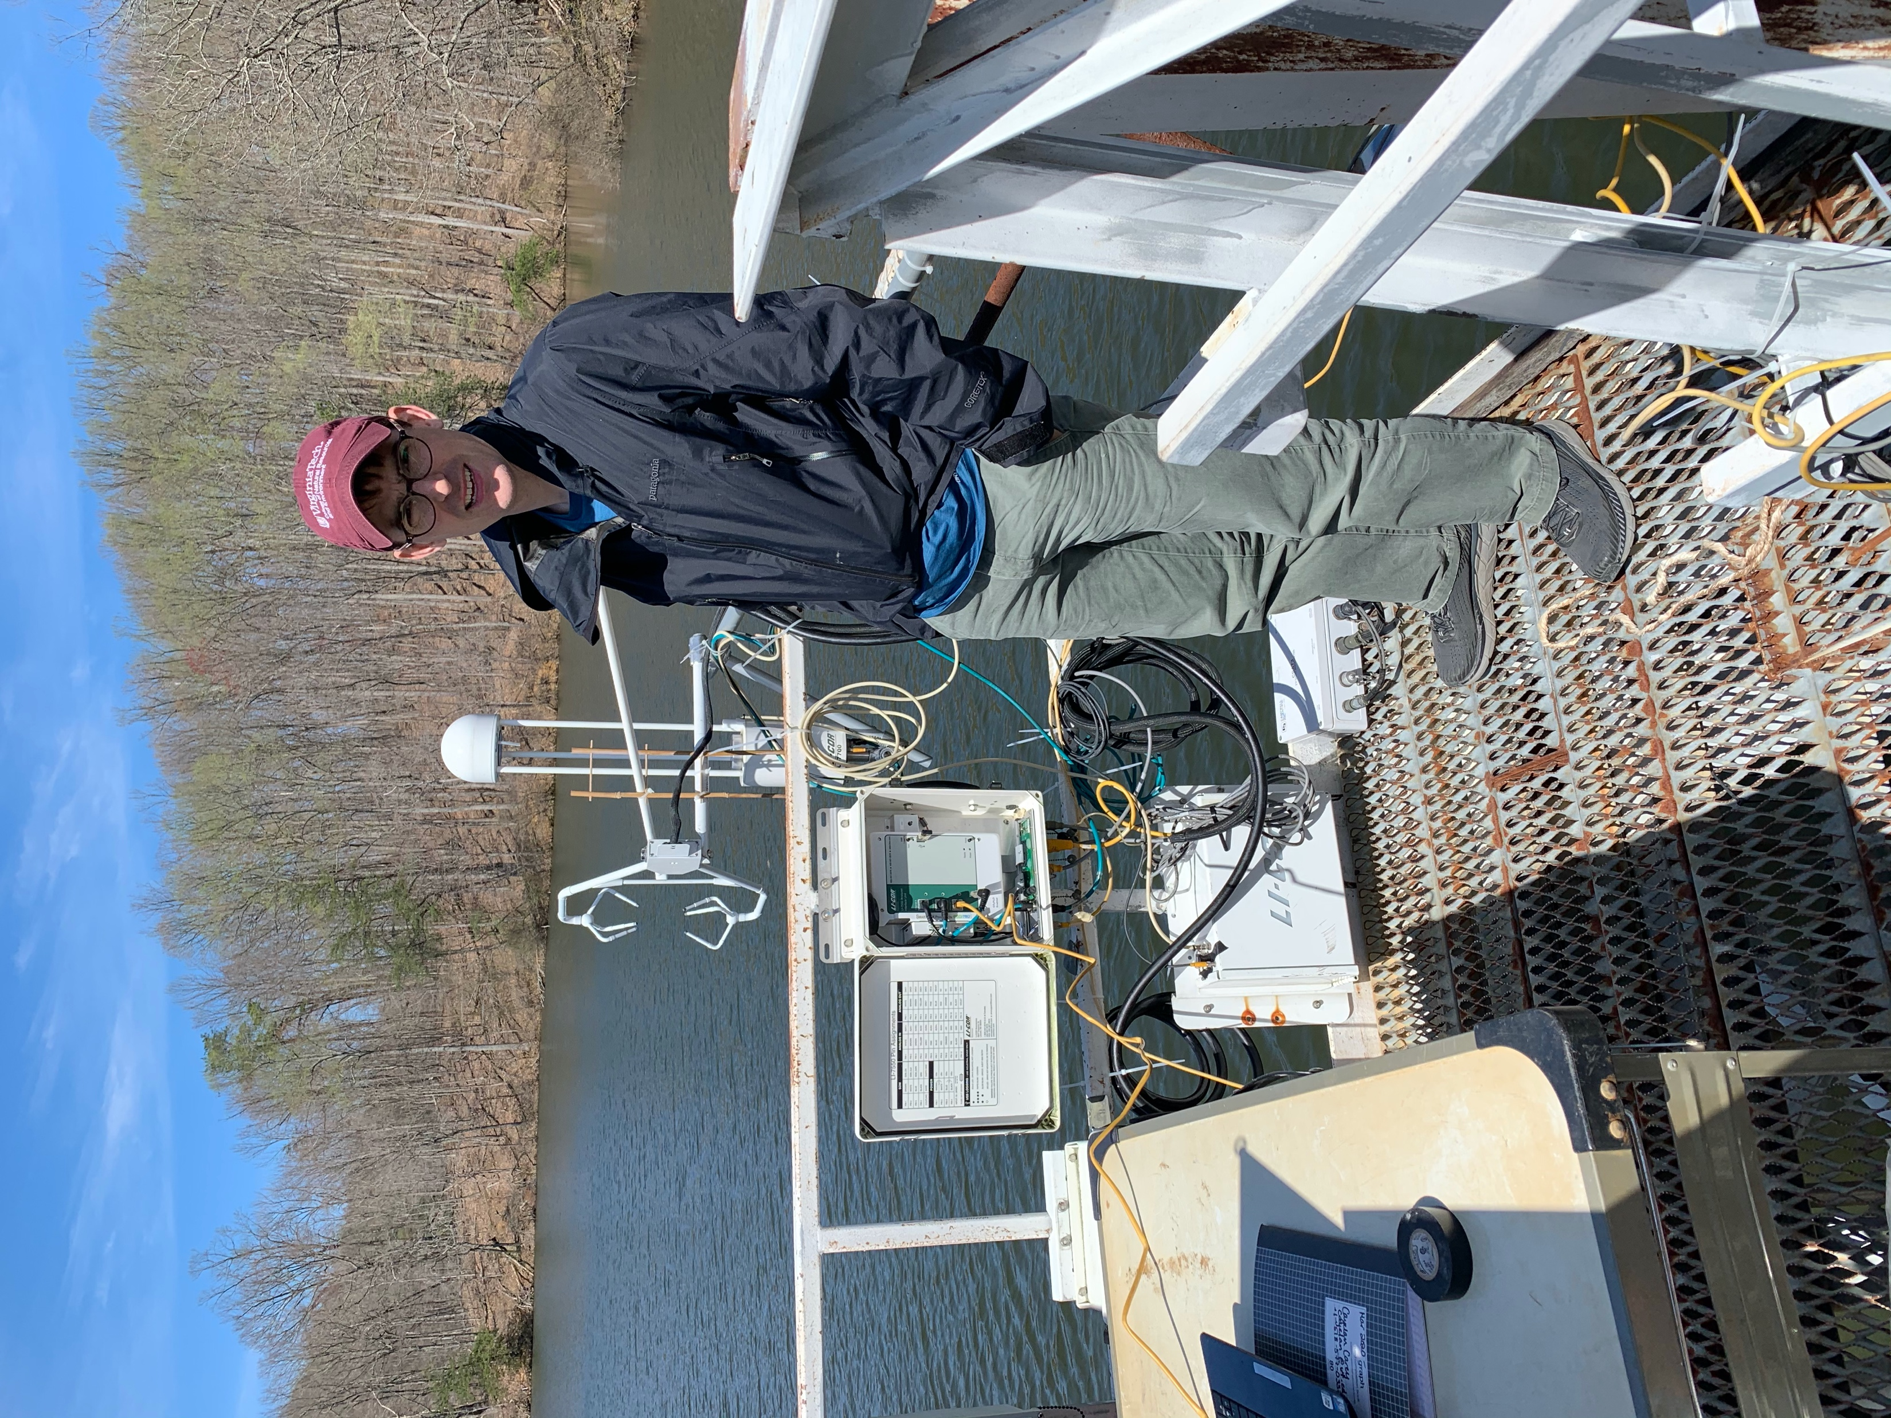
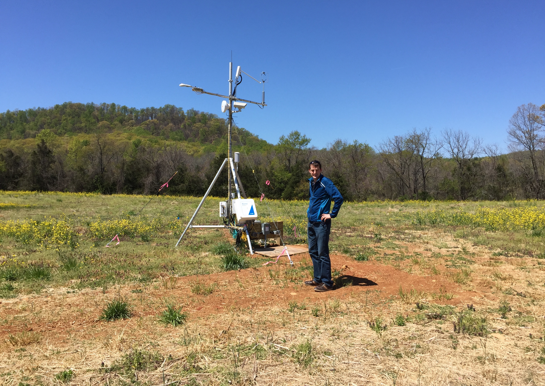

Slide 15
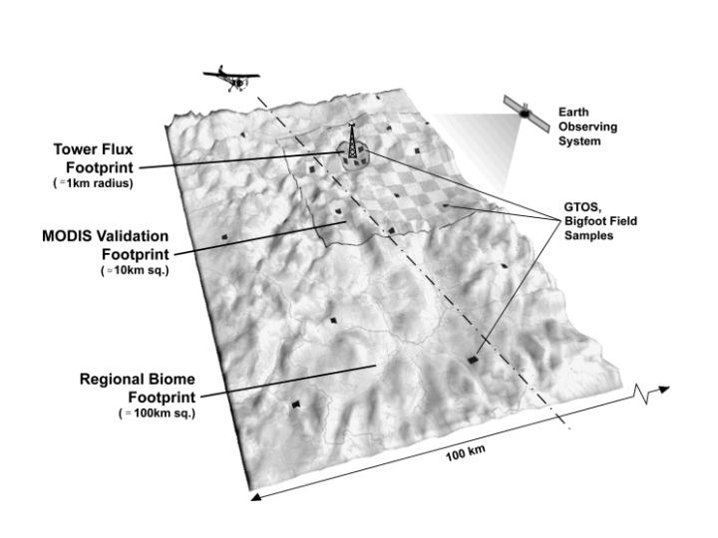
Methodological strengths
Medium-spatial scale resolution (1 km²)
Integrates multiple flux sources
Very high temporal resolution (1/2 hour)
Relatively high accuracy
Source: NASA

Slide 16
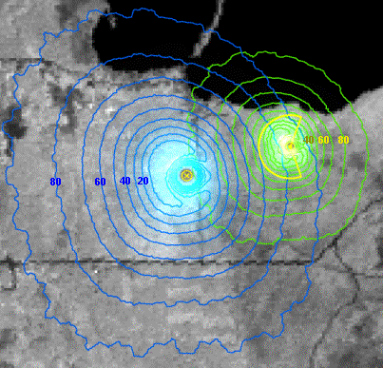
Methodological limitations
Flux “footprint” size and location varies over time
Must have wind!
Not amenable to complex terrain
Does not tell you where carbon (or other trace gases) go once they enter the ecosystem
Remains computationally intensive
Credit: Gil Bohrer
Notes:
The figure above shows the footprint probability, with, for example, “80” indicating that 80 % of the carbon fluxes originate within the mapped area.

Slide 17
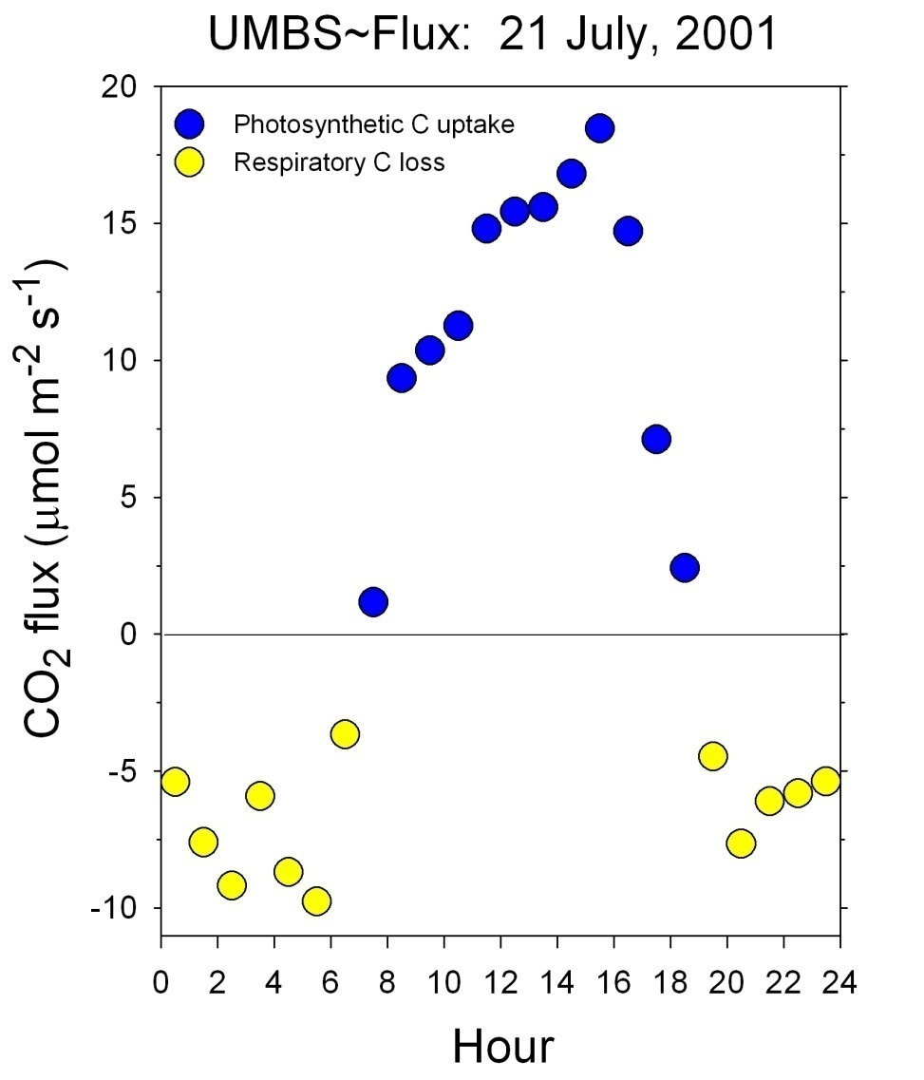
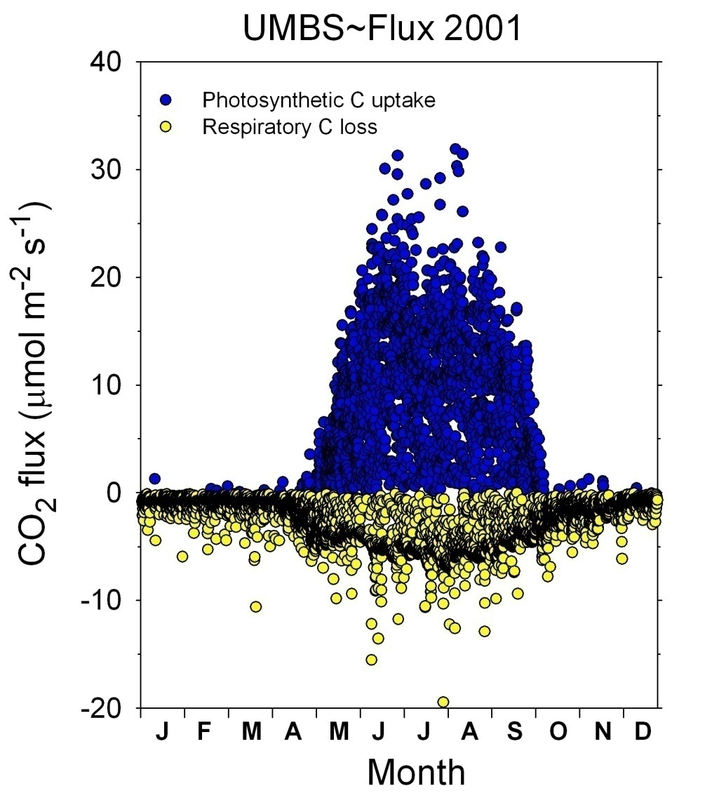
Total daytime uptake: 98.9 mmol CO₂ m⁻²
Total nighttime loss: 57.3 mmol CO₂ m⁻²
Net 24 hour gain: 41.6 mmol CO₂ m⁻²
or, 5.0 kg C ha⁻¹ (27 lbs C per acre)
Total daytime uptake: 7,402 kg C ha⁻¹
Total nighttime loss: 6,599 kg C ha⁻¹
Net annual gain: 803 kg C ha⁻¹
(2.2 short tons C per acre)
Notes:
Instantaneous rates (y-axis) are in micromoles. When summed over the course of a day, the quantity amounts to millimoles.

Slide 18
Towers measure Net Ecosystem Productivity
Net Ecosystem Productivity =
Photosynthesis – Respiration
or
NEP = GPP – Re

Slide 19
Daytime =
Photosynthesis – Respiration =
GPP - Re
We can use the nighttime measurements to determine Re and remove Re from NEP in the day to get GPP
Nighttime =
no photosynthesis =
- Re
Notes:
Instantaneous rates (y-axis) are in micromoles. When summed over the course of a day, the quantity amounts to millimoles.

Slide 20
The value of observational networks A proliferation of eddy-covariance towers is enabling understanding of ecosystem carbon fluxes worldwide.
Credit: https://fluxnet.fluxdata.org/about/
Credit: Whittaker, 1975
We might expect that climate variability affects carbon fluxes, making a global network of eddy-covariance towers critical to understanding how different ecosystems in different climate zones cycle carbon.

